Slide 1
2022
Medicare Advantage Plans
<Sales Rep>
Licensed Medicare Sales Representative
Y0089_MP9766_M Approved 10/8/2021

Slide 2
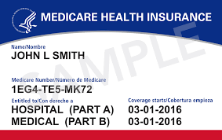
Welcome
Today we’ll cover
Overview of Health First Health Plans
Basics of Medicare
Enrollment Periods
Our 2022 Medicare Advantage Plans
Classic Plan (HMO-POS)
Value Plan (HMO)
Rewards Plan (HMO)
Secure Plan (HMO)
This plan has no Part D, or
prescription drug benefits
Help Paying for Costs
Enrollment Options
2

Slide 3
About Health First Health Plans
Health First is our parent company
Formed in August 1995
A private, not-for-profit Integrated Delivery Network (IDN) that combines health insurance, four hospitals, a multispecialty medical group and wellness services for our community.
Membership (as of September 2021)
More than 37,000 Medicare Advantage members
More than 100,000 Individual members
3

Slide 4
About Health First Health Plans
Office Location
6450 U.S. Highway 1, Rockledge, FL 32955
Lobby/walk-in hours: 8 a.m. to 5 p.m. Monday through Friday
Customer Service
1.800.716.7737 (Toll-Free)
1.800.955.8771 (TDD/TTY Relay)
Customer Service Hours
8 a.m. to 8 p.m. weekdays; 8 a.m. to noon Saturdays
From October 1 to March 31, Customer Service is available seven days a week from 8 a.m. to 8 p.m.
myHFHP.org
4

Slide 5
Our Network Hospitals
Health First Hospitals
Health First’s Cape Canaveral Hospital
Health First’s Holmes Regional Medical Center
Health First’s Palm Bay Hospital Health First’s Viera Hospital
6

Slide 6
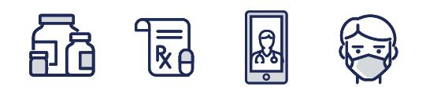
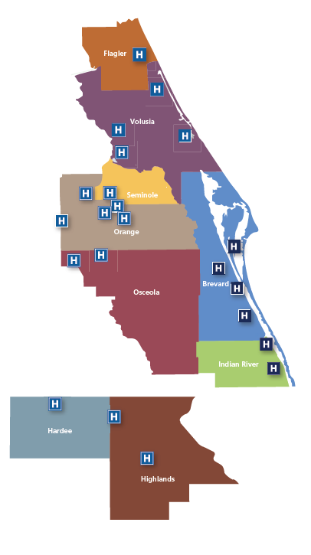
Our Network Hospitals (continued)
Health First and AdventHealth have come together to offer an extensive provider network throughout Central Florida.
Our network allows all Health First Health Plans Medicare Advantage members access to more than 4,000 providers across Central Florida.
A list of providers, their locations and contact information can be found in the provider directory at myHFHP.org/directory

Slide 7
ABCDs of Medicare
A
Hospital
Insurance
Hospitals
Hospice
Home Health
Skilled Nursing Facility
Has deductible and cost sharing
B
Medical
Insurance
Physician services
Diagnostic services
Preventive services
Outpatient services
Medical equipment
Some drugs
Has deductible and cost sharing
C
Medicare
Advantage
Medicare Advantage
Could include Dental, Vision and Hearing benefits
May include Prescription drug coverage
Private insurance companies
D
Prescription
Drug Coverage
A stand-alone prescription drug plan (PDP)
- OR -
Medicare Advantage- Prescription Drug Plan (MAPD) that offers both medical and drug benefits

Slide 8
What are Medicare Advantage Plans?
Replacement Plans:
C
Who Can Join
Medicare Advantage?
You Must:
Medicare Part A and Part B services covered
through Health First
No longer paid for under Original Medicare
May include Prescription Drug Coverage
Health First Classic, Value and Rewards plans include prescription coverage
Contracted with the Centers for Medicare
& Medicaid Services (CMS)
These are not Medigap or Medicare Supplemental Plans
Be entitled to Part A
Be enrolled in Part B
Continue to pay Part B
premium
Live in plan’s service area

Slide 9
Medicare Penalties
Medical Coverage Part B
Failing to Enroll in Part B Could Cost You
Prescription Drug Coverage Part D
Calculating Part D Penalties
Your monthly Part B premium will go up 10% for each year that you neglected to sign up
1% x # = $
One percent of average monthly prescription drug premium
Number of months you were late
The amount of your penalty
Note: You will not receive penalty if you have creditable coverage.

Slide 10
Medicare Enrollment Periods
Initial Enrollment Period (IEP)
Applies when first eligible for Medicare Parts A and B
During this time, you may join Medicare Parts A, B, C and D
65
The month of your 65th birthday
3 months before your 65th birthday
3 months after your 65th birthday
Annual Enrollment Period (AEP)
Each year a Medicare beneficiary may add, change or drop their Medicare Advantage or PDP plan.
OCT NOV DEC
October 15 through December 7
JAN
Coverage begins January 1st

Slide 11
Open Enrollment Period (OEP)
From January 1 through March 31: The Medicare Advantage OEP is only for those beneficiaries who are enrolled in a Medicare Advantage Plan. These beneficiaries are allowed to make a one-time switch to a new plan.
You can switch from one Medicare Advantage Plan to
another Medicare Advantage Plan.
- OR -
Dis-enroll from a Medicare Advantage plan to return to Original Medicare Part A and Part B and sign up for a stand- alone Medicare Part D Prescription Drug Plan.

Slide 12
Medicare Special Enrollment Periods (SEP)
Moving | You moved out of the plan’s service area
Work | You leave or lose employer or union coverage
Nursing Facility Change | Move in or out of an institution (i.e., skilled nursing facility)
Extra Help | You qualify for Extra Help paying for your prescription drug coverage – OR – You no longer qualify for Extra Help
Medicaid | You become eligible for Medicaid – OR – You are no longer eligible for Medicaid

Slide 13
Medicare Enrollment Periods
General Enrollment Period (GEP)
If you miss the Initial Enrollment Period, you have another chance to enroll into Medicare Part B.
Note: The Part B penalty may apply
JAN
FEB MAR
APR MAY JUN
JUL
Coverage begins July 1st
January 1st through March 31st

Slide 14
Continuing Low-Cost Benefits for 2022
$0 Premium Plans & Primary Care Copay
$0 Prescription Drug options
No Referrals to See a Specialist
More than 4,000 Providers
No Deductibles
Worldwide Urgent & Emergency Care
Notes:
They do not need a referral to see a specialists, however they still may require Prior Authorization which is entirely different than a referral. While the plan does not require referrals, the specialist provider may.

Slide 15
New Benefits 2022 Increased Dental & Vision Benefits
DENTAL
$1,000
ANNUAL ALLOWANCE *
EYE EXAM
$0 Routine Non-Medicare Covered Eye Exams
EYEWEAR
$300
ANNUAL ALLOWANCE *
PLUS
Quarterly over-the-counter allowances, $0 gym benefit (Silver & Fit), wellness rewards program, Virtual Health, $0 non-emergency transportation
and routine hearing benefits!
*Plan limitations and Restrictions may apply.
Please review the Evidence of Coverage Booklet for your plan for more details on this benefit.

Slide 16
2022 Prescription Drug Tiers
Health First Health Plans offers many Generic Medications at a $0 copay
*Preferred Pharmacies: Health First Family Pharmacy, Publix, Walmart, CVS, Target

Slide 17
2022 Standard Part D: Out-of-Pocket Costs
Yearly Deductible (Our Plan has NO Deductible)
$0
Initial Coverage (Includes member’s copay and insurance cost)
$4,430
Coverage Gap (excludes insurance cost)
(Our Plan offers some coverage in the GAP)
Generics 25% Brand Name 25%
Catastrophic Coverage $7,050
Generics or Preferred Multisource with retail under $79 = $3.95*
Brand name under $197 = $9.85 or above $197 = 5%

Slide 18
Get Help Paying for Costs Medicare Part D Low Income Subsidy (LIS) “Extra Help” to pay for your prescription drug costs and
exemption from the Coverage Gap
2021 Extra Help Eligibility
Yearly Income: Must be limited to $19,140 Individual / $25,860 Married
Resources: May not exceed $14,790 Individual / $29,520 Married (Checking, Savings, Stocks & Bonds)
2022 Premium Reductions with 100% LIS
Classic plan premium reduced to $62.70
Value plan premium reduced to $0

Slide 19
Hello,
Oscar
An online account worth using
Review plan details, access your digital ID card, search in-network doctors and drugs, and more
New for 2022:
We offer an easy-to-use app, to provide convenient care. It’s the kind of care you’re looking for and the kind of care that just makes sense.
Message a Care Guide in the app
Chat with a Care Guide right from your phone and get your questions answered instantly

Slide 20
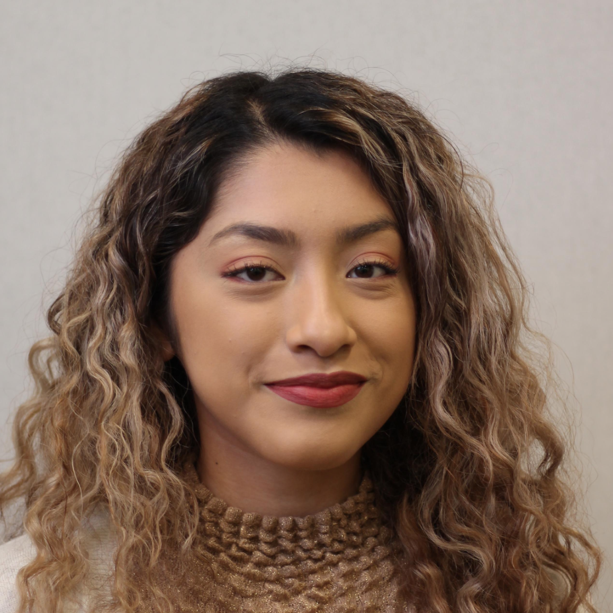
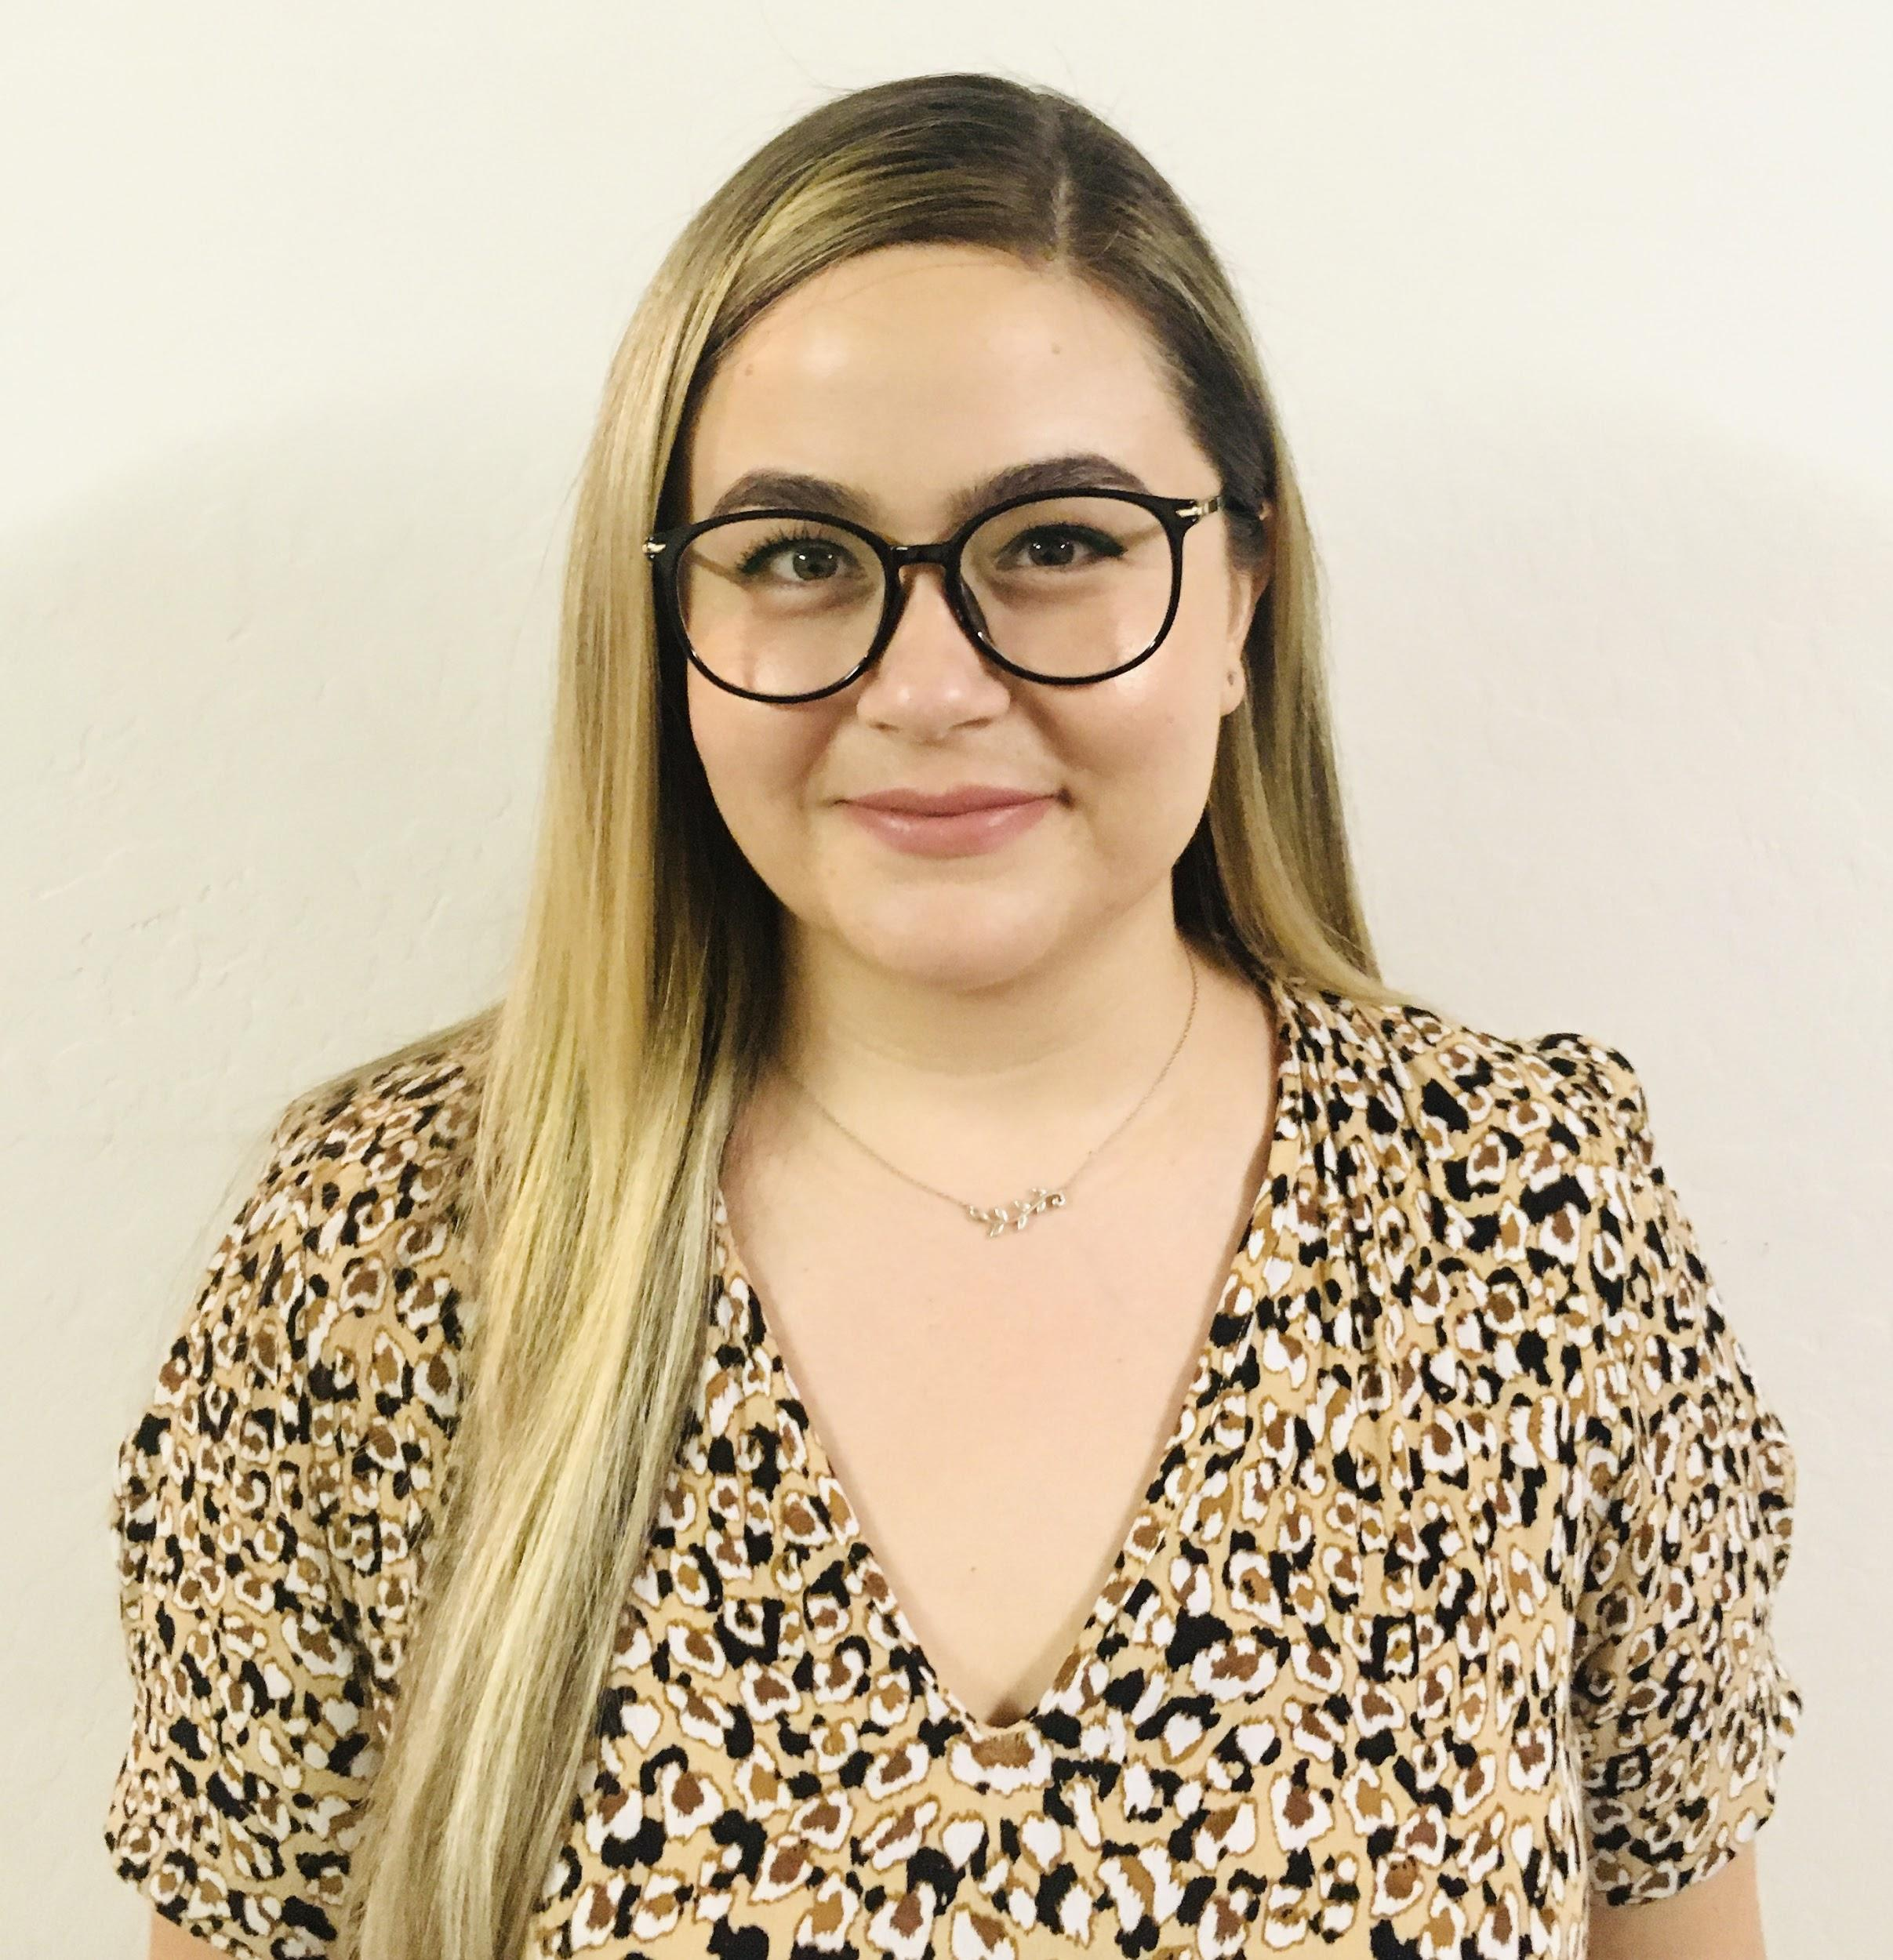
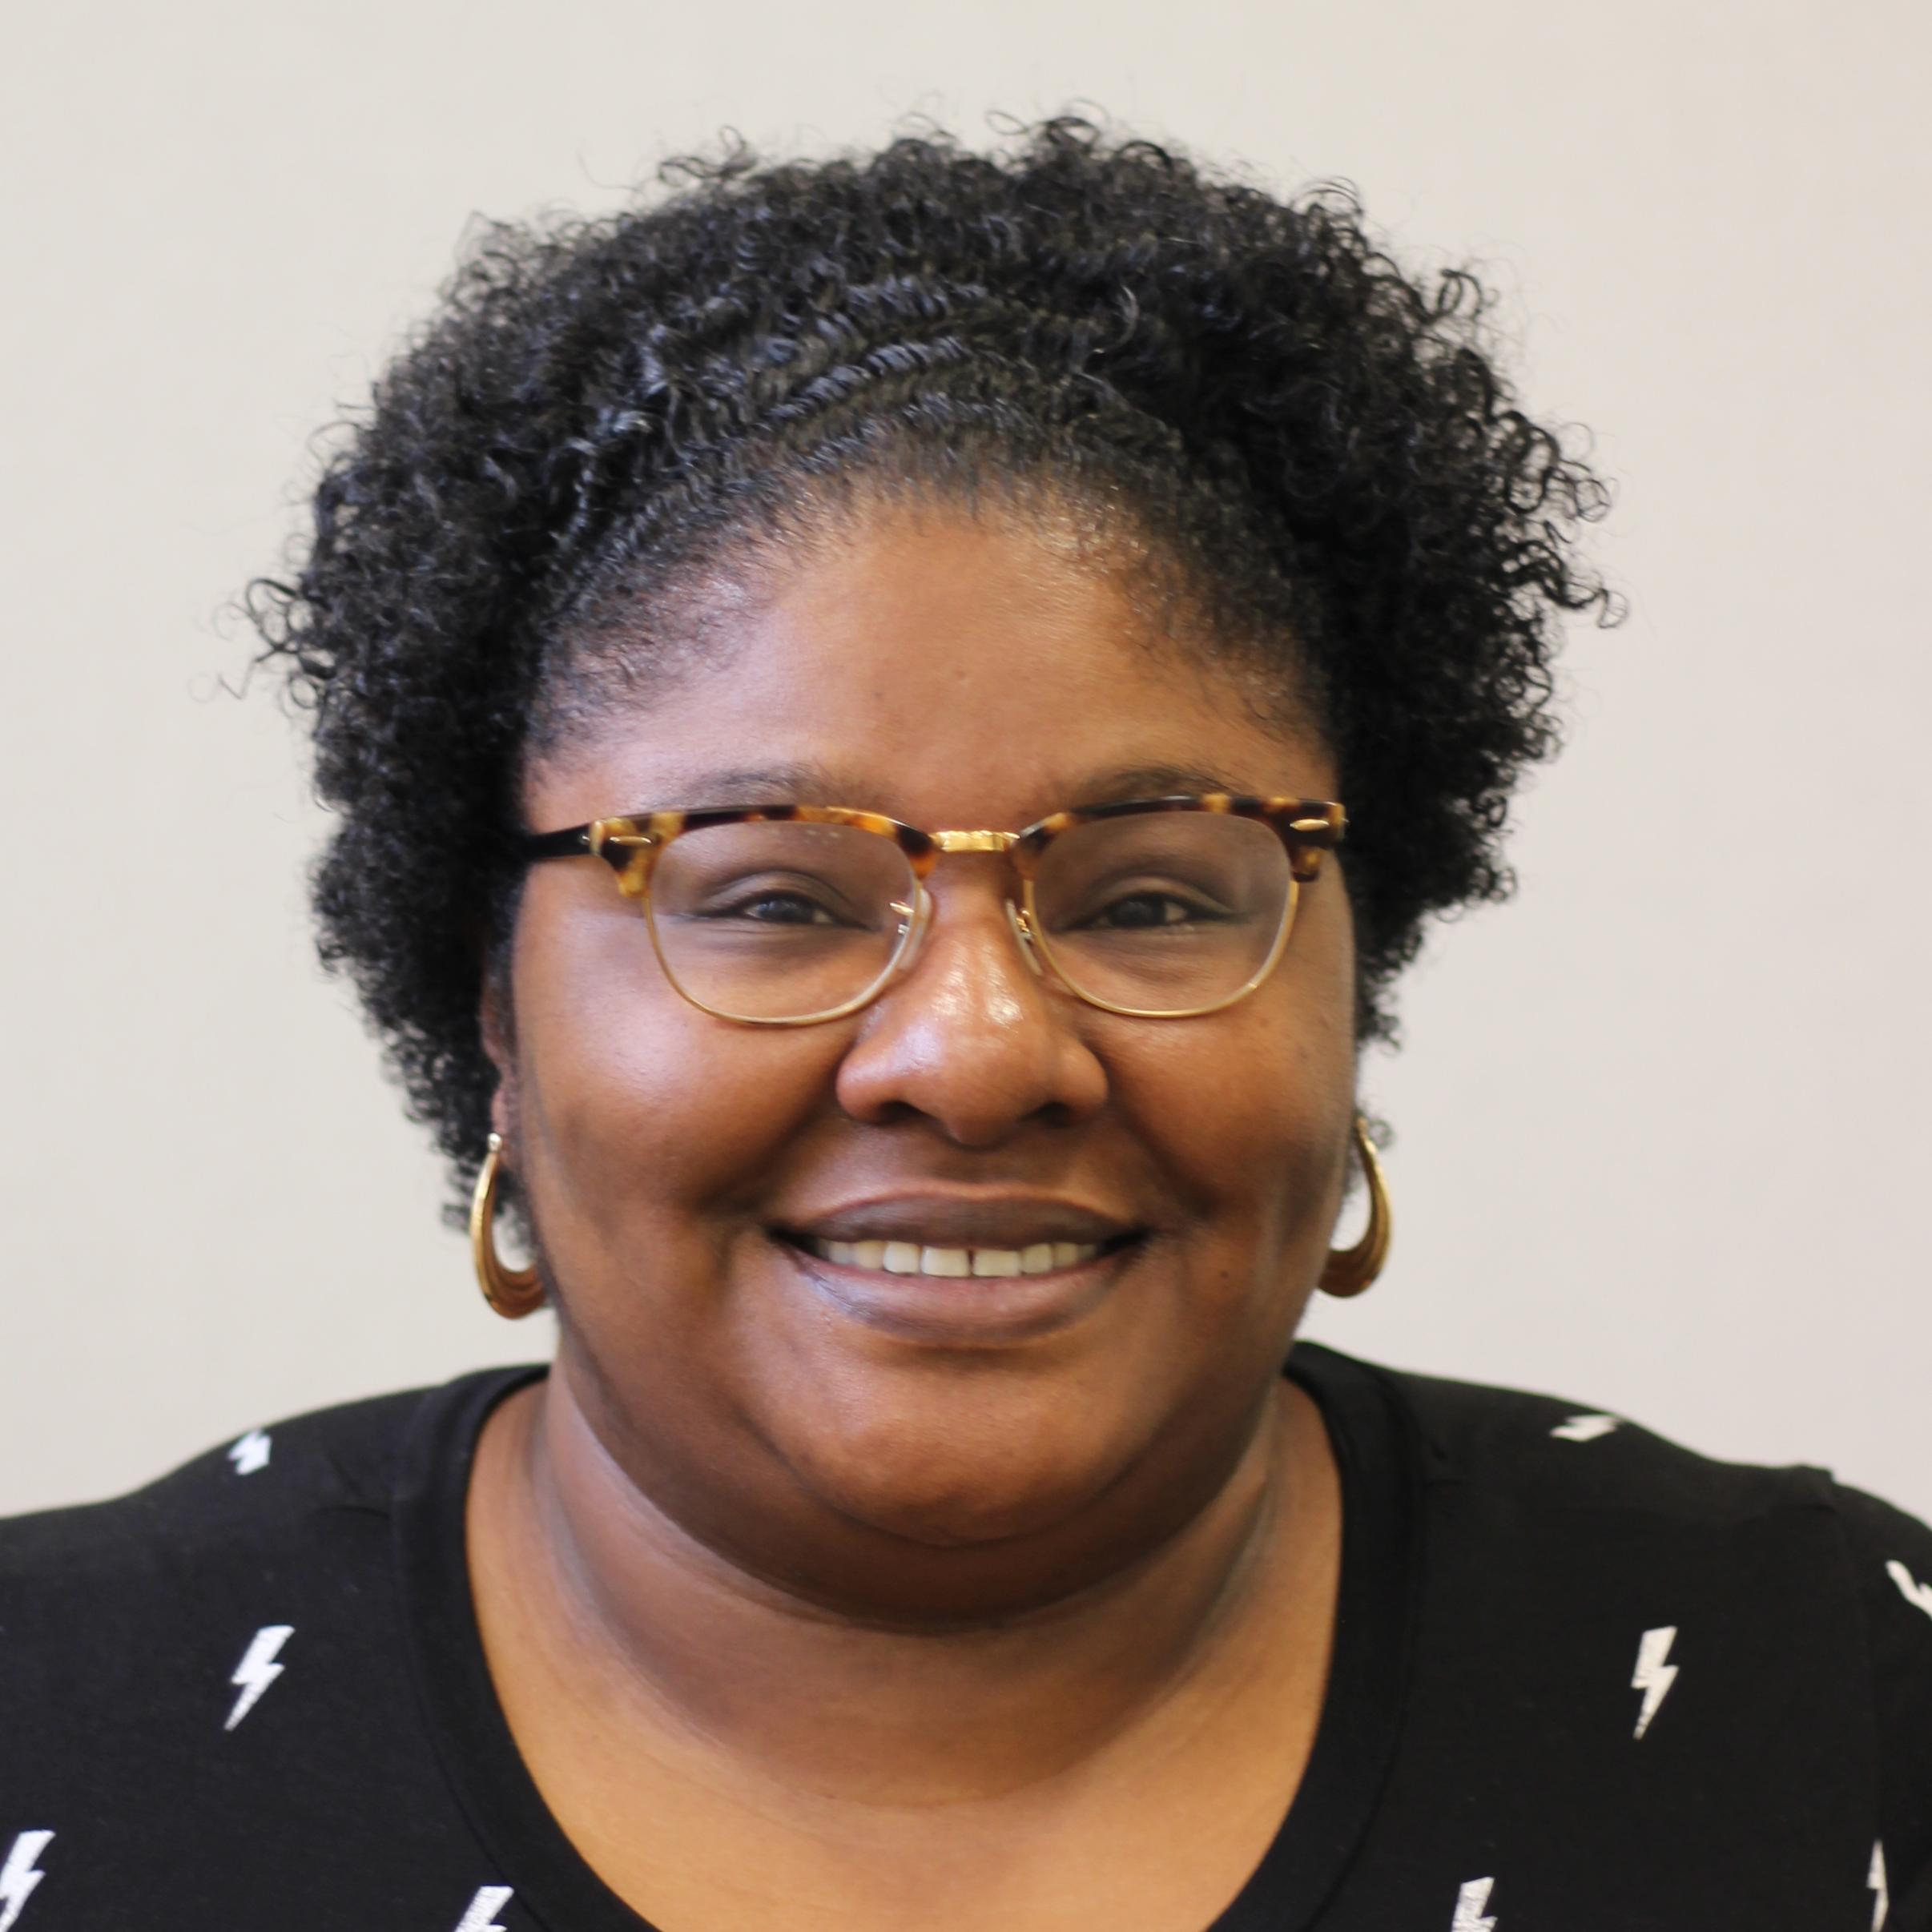
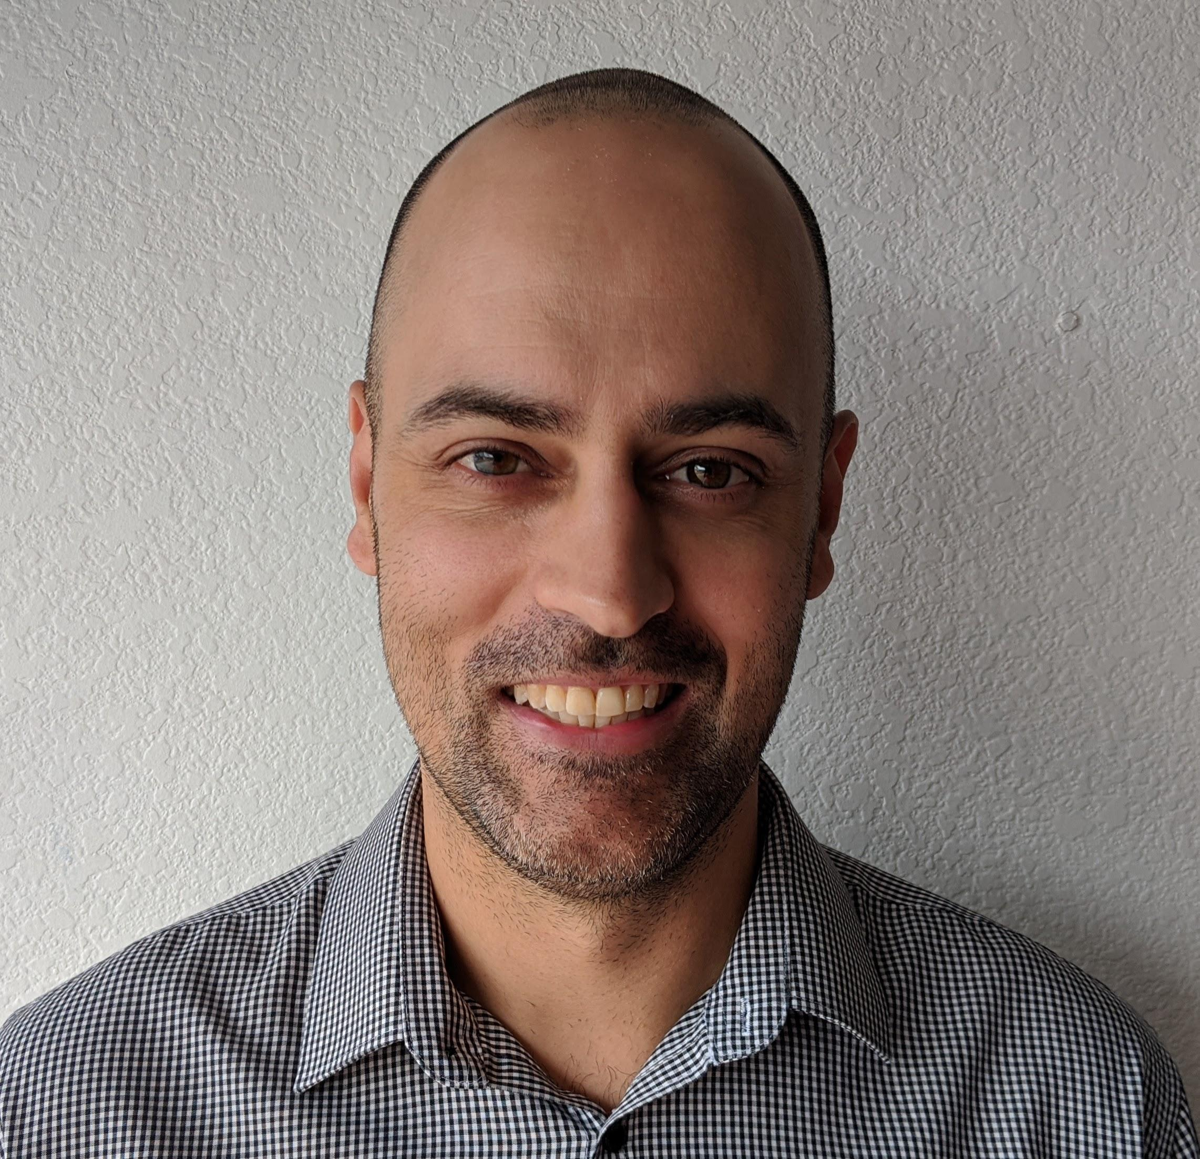
A different kind of customer service
Your Care Guides have one job, to help you get the most out of the system.
This year, each member will have their own team to:
Answer plan questions
Help with preparing for a procedure
Look for ways to help you save
Find in-network doctors and drugs
And more…
Your Care Team knows you and your history, so you won’t get transferred to five people to answer one simple question.
Some of the people you may get to know on a first name basis.
Licensed Nurse
Care Guide
Care Guide
Care Guide

Slide 21
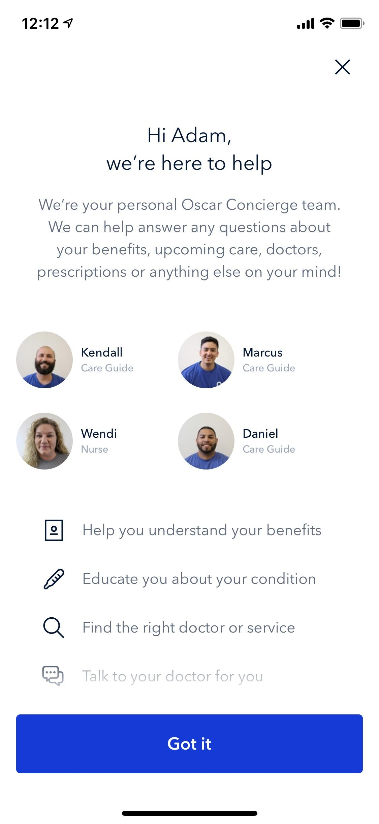
The Oscar app makes accessing care simple
Available through the mobile app or any desktop computer
See claims, lab results and plan details whenever
Access your digital member ID card
Message or call Care Guides
Search for in-network doctors and facilities

Slide 22
Do You Have Other Insurance?
If you currently have health coverage through an Employer, Union, One Exchange or AON (Brevard County Schools), joining a plan could:
Affect your employer or union health benefits, including prescription drug coverage
Cause loss of your employer or union coverage
Important: Read the communications your employer or union sends. If you have questions, visit their website or contact the office listed in their communications. If there is no information on whom to contact, your benefits administrator or the office that answers questions about your coverage can help.

Slide 23
How to Enroll
Enroll Today
Complete the form included in your enrollment packet.
Request a Telephone Enrollment or Home Appointment
Toll Free: 1.800.716.7737
TDD/TTY: 1.800.955.8771
Come to our office
Call your Sales Representative directly to make an appointment.
Enroll Online
Directly through Health First Health Plans at myHFHP.org
Medicare beneficiaries may also enroll in Health First Health Plans through the CMS Medicare Online Enrollment Center located at http://www.medicare.gov

Slide 24
Disclaimers
Health First Health Plans is an HMO plan with a Medicare contract. Enrollment in Health First Health Plans depends on contract renewal.
Other pharmacies, physicians and providers are available in
our network.
This information is available for free in other languages. Please call our Care Team number at 1.800.716.7737 or TDD/TTY relay 1.800.955.8771. From October 1 to March 31, we’re available seven days a week from 8 a.m. to 8 p.m.
This information is not a complete description of benefits. Call 1.800.716.7737 or TDD/TTY relay 1.800.955.8771 for more information.

Slide 25
Questions?
Thank you for attending today!

